Slide 1
STE
LUSD 2015
AM
Festival
Science Technology Engineering Arts Mathematics
Districtwide STEAM Community Outreach
Friday, May 29, 2015
Lompoc High School Cafeteria & Surrounding Area
6 to 8 PM

Slide 2
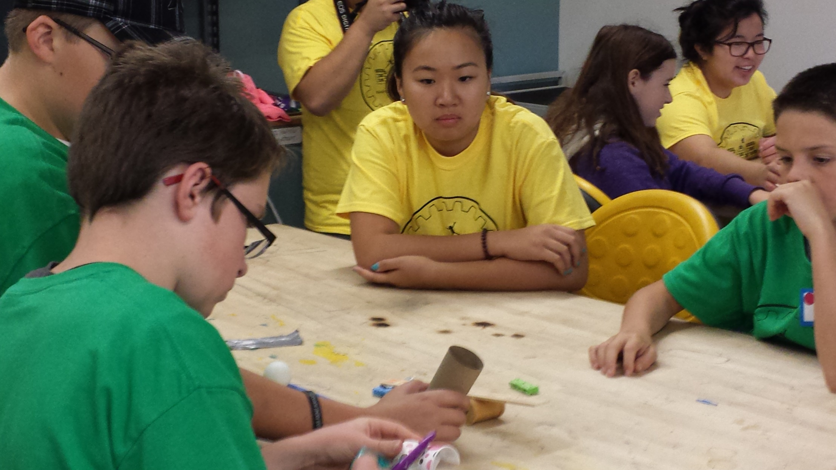
Design & Engineer

Slide 3
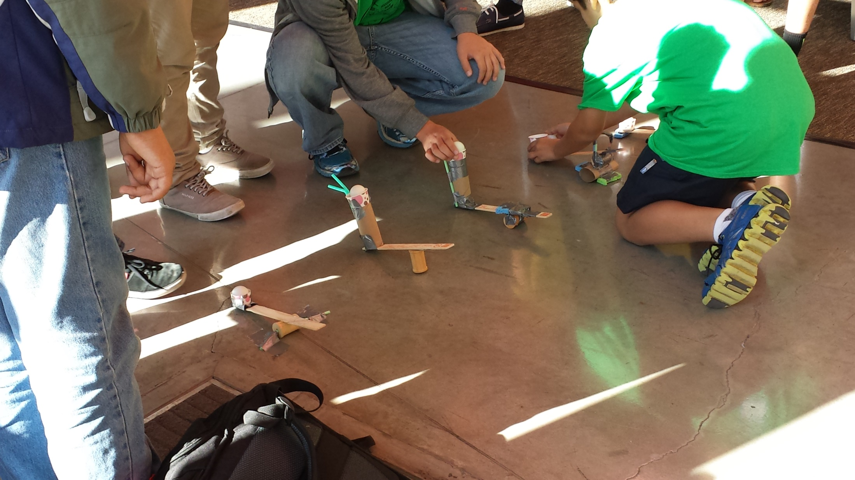
Catapult Prototypes

Slide 4
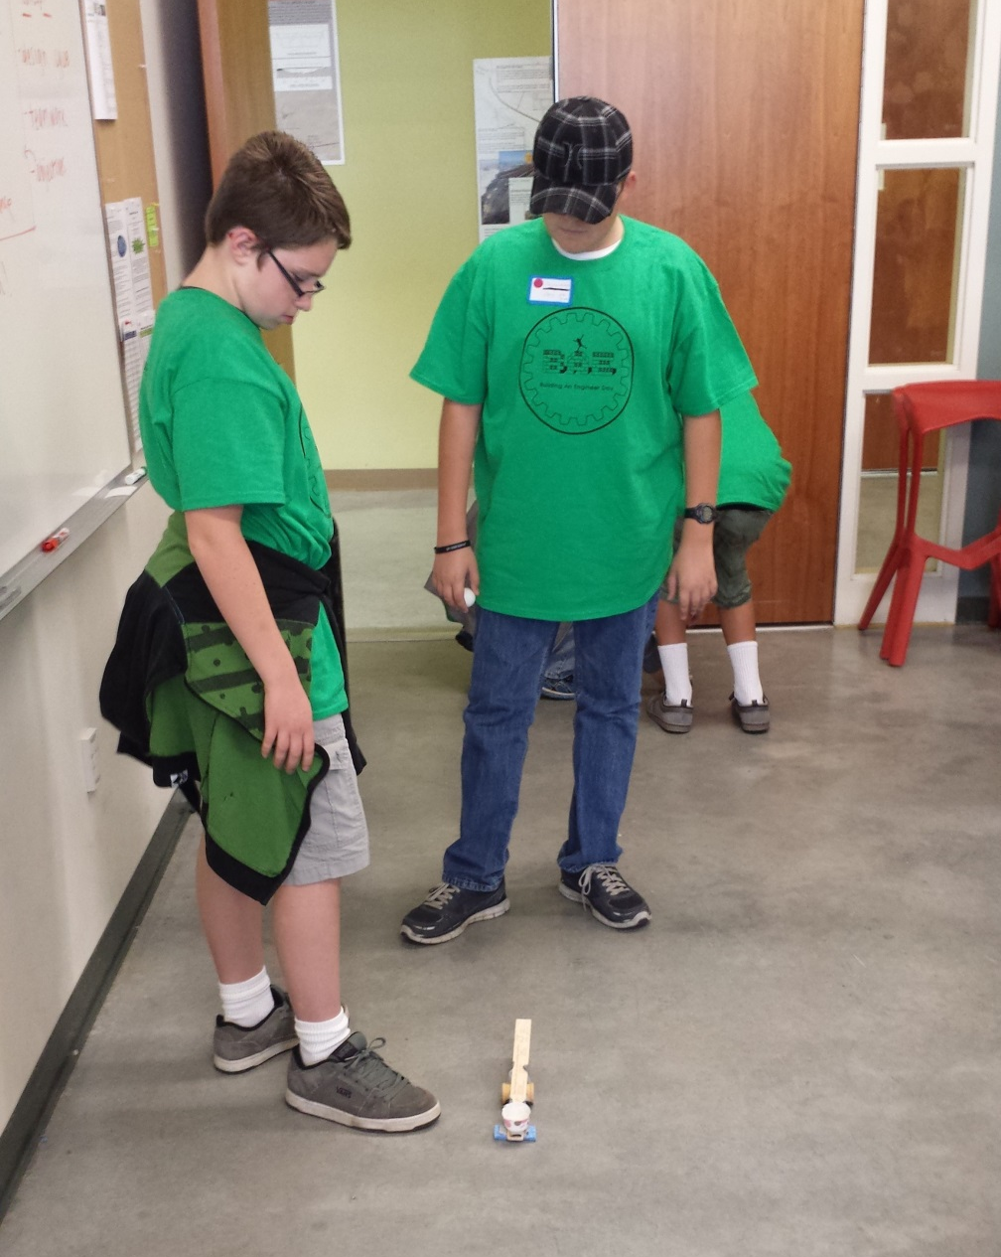
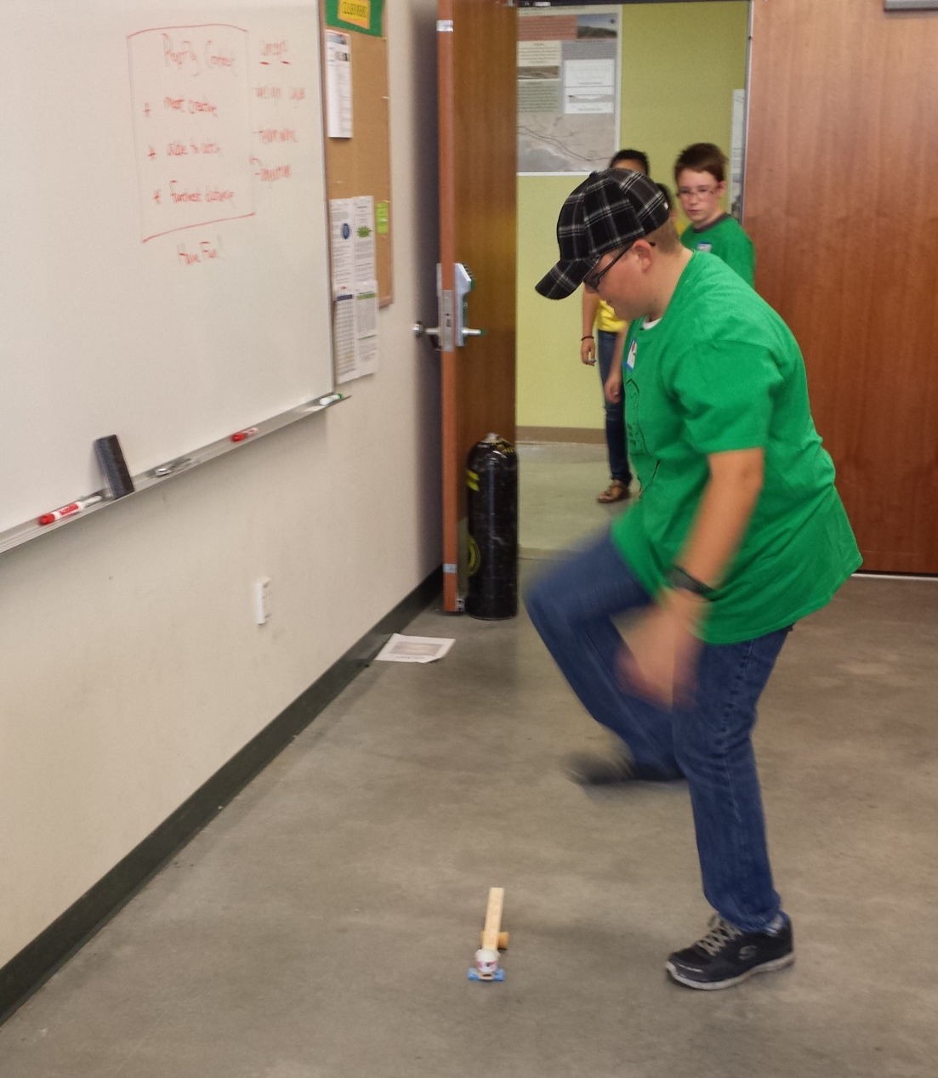
Testing Foot Stomp Catapult

Slide 5
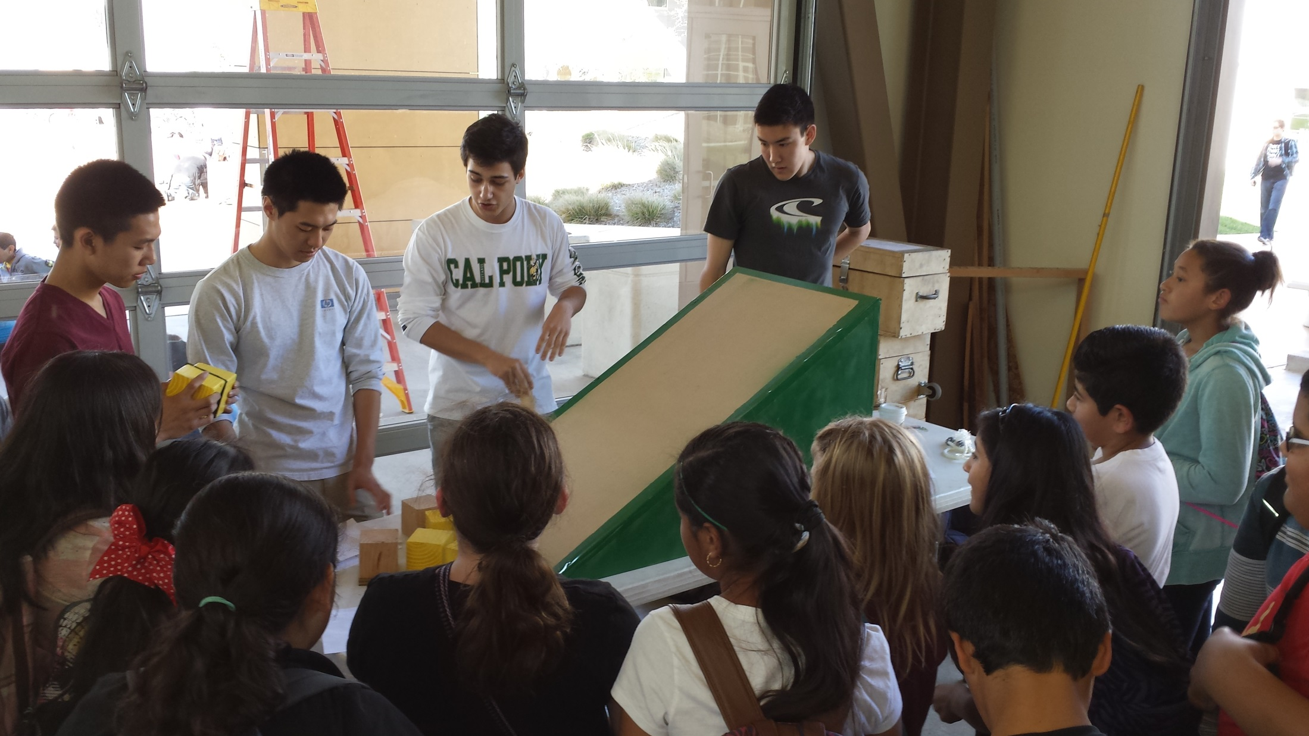
Sliding Friction Demo

Slide 6
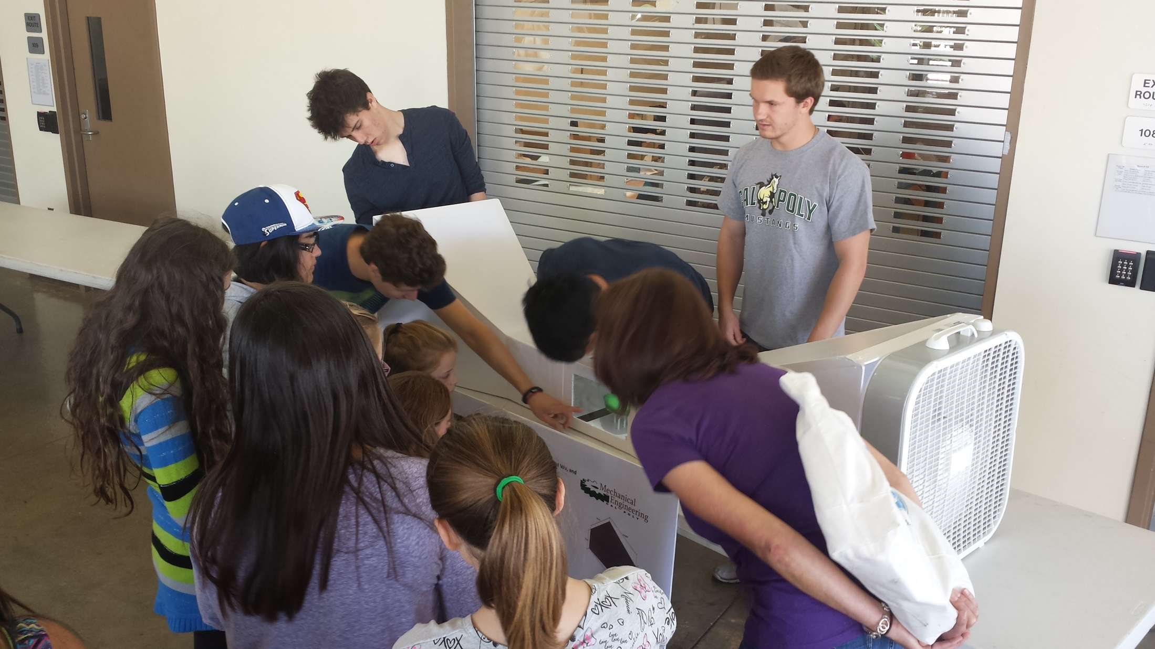
Wind tunnel test of student clay models

Slide 7
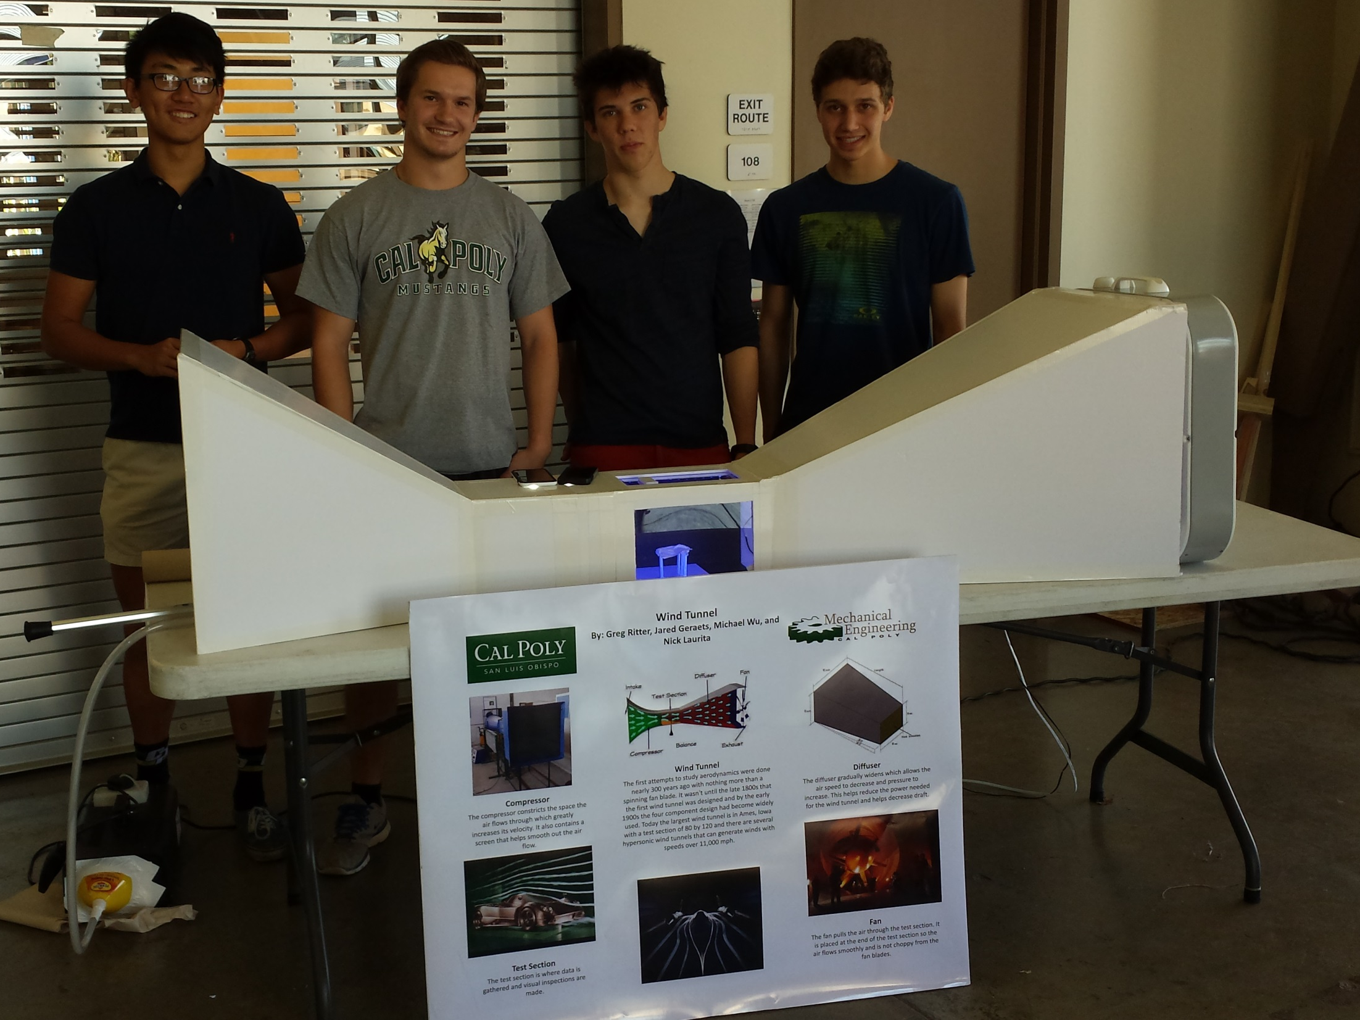

Slide 8
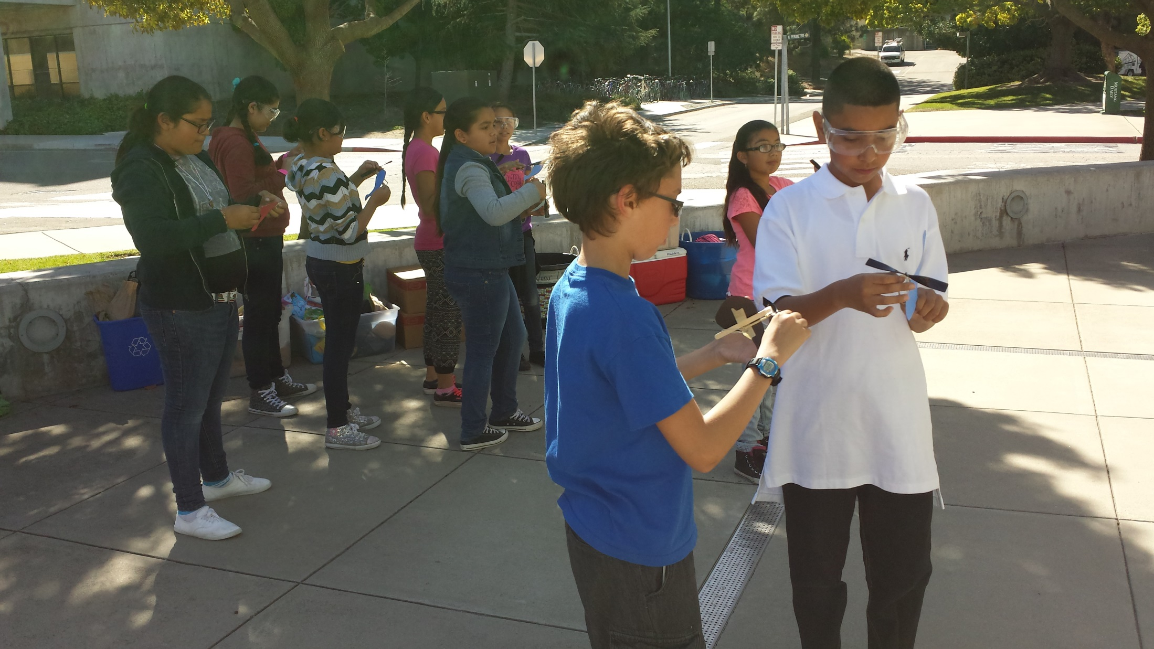
Helicopter build station

Slide 9
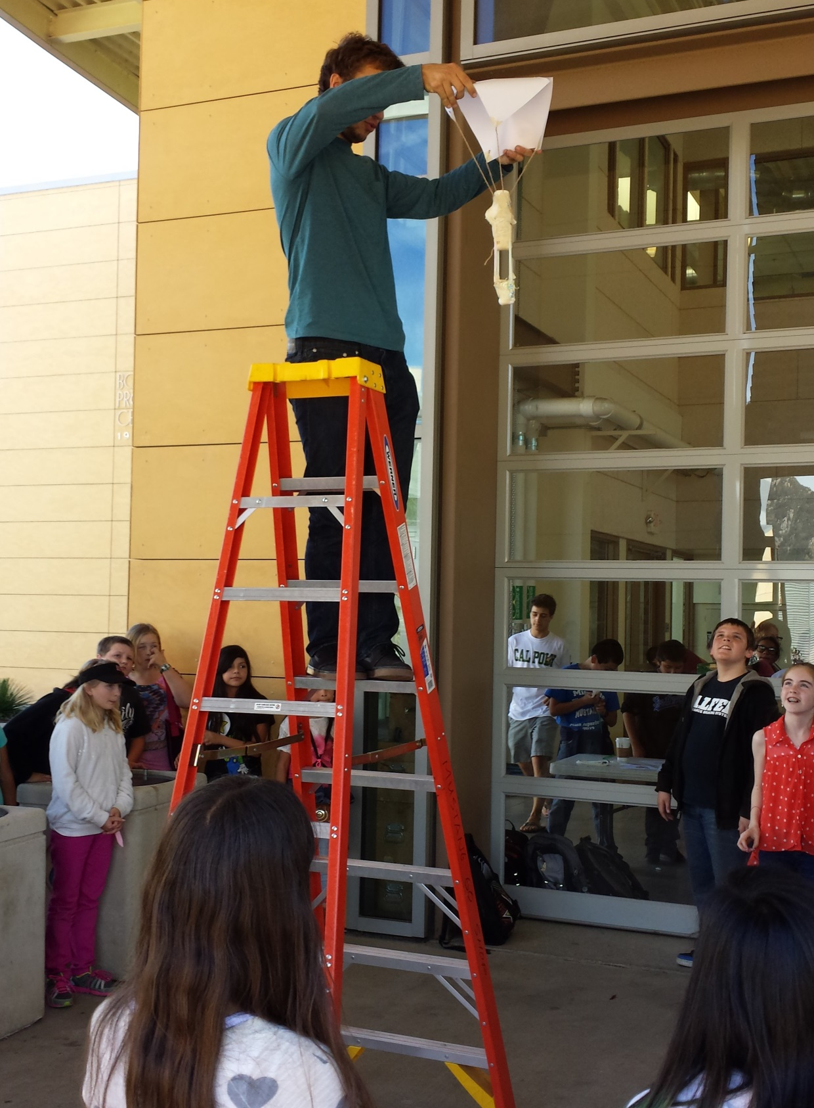
Recovery system design test

Slide 10
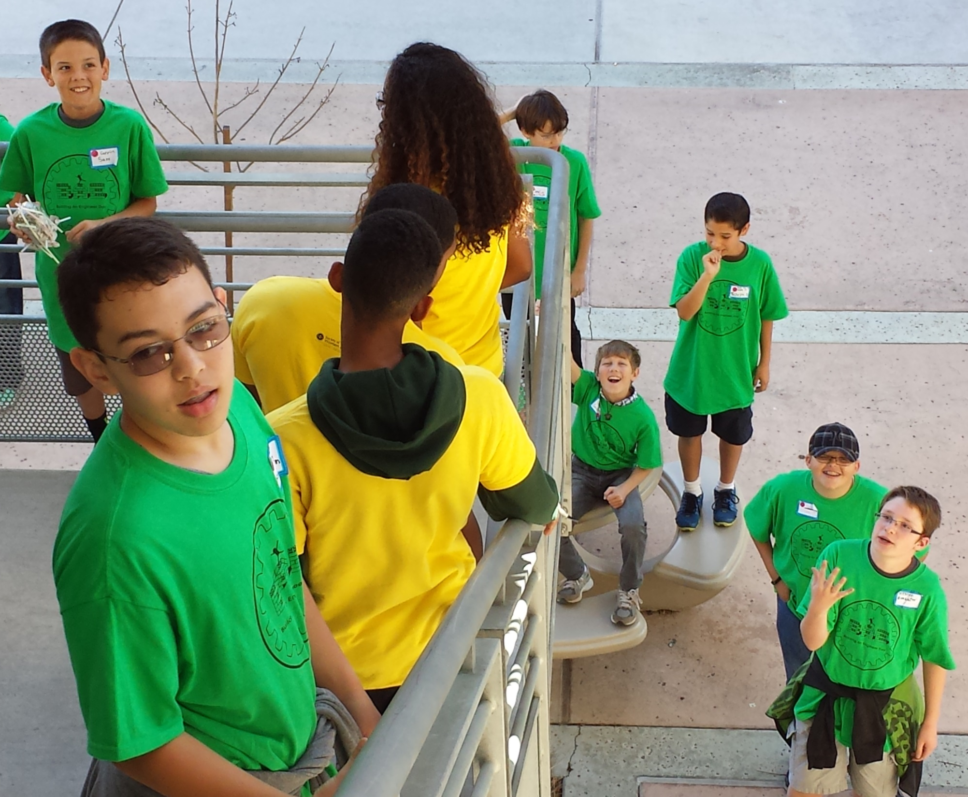
Egg Drop

Slide 11
Whirly bird construction

Slide 12
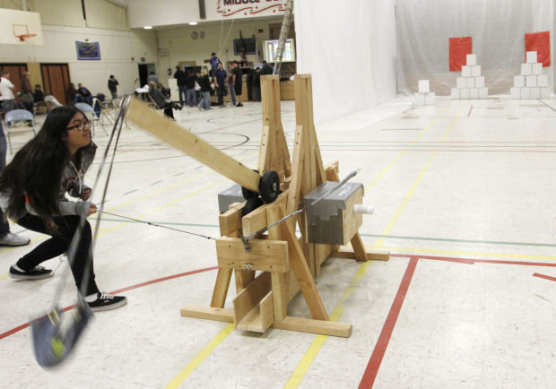
Trebuchet Wall Buster

Slide 13
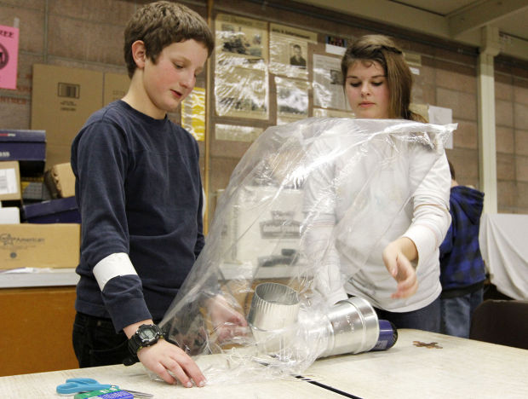
Hot Air Balloon

Slide 14
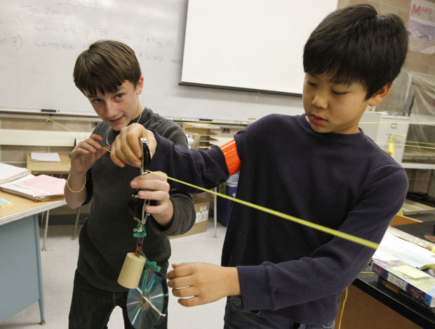
Zip line Races

Slide 15
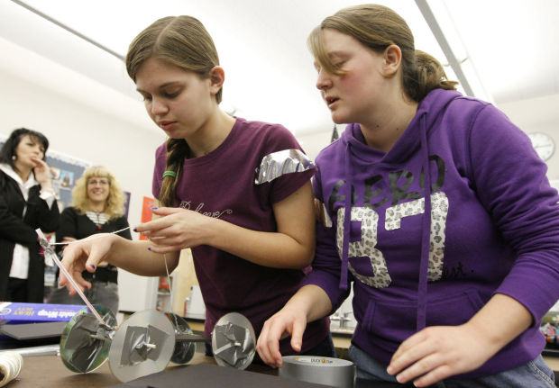
Rubber band powered cars

Slide 16
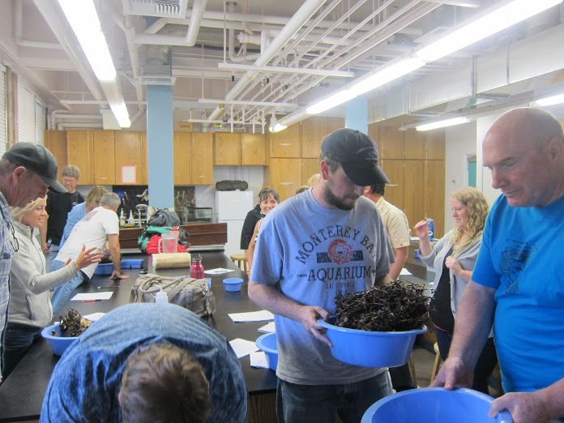
Kelp Holdfast Investigation

Slide 17
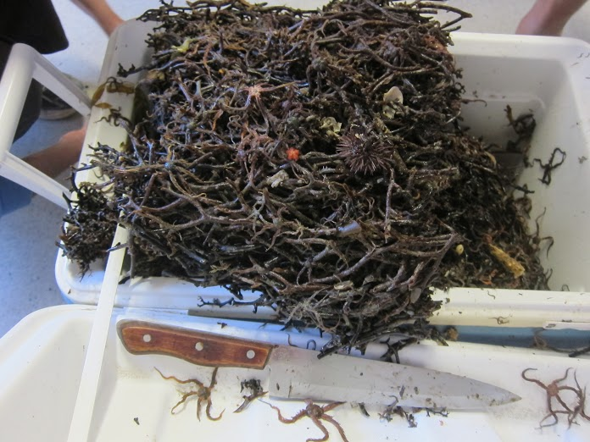

Slide 18
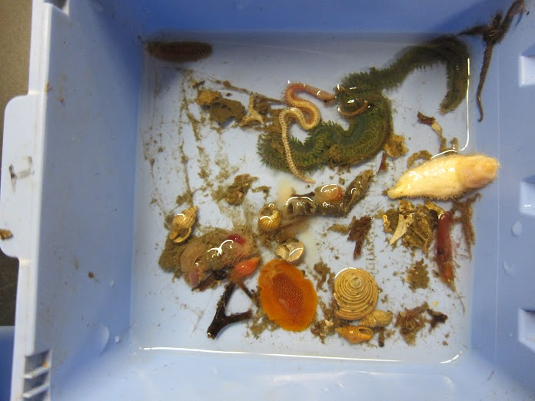
https://www.flickr.com/photos/usasef/with/14628274421/

Slide 19
Who are we seeking to Participate?
Teachers
Clubs
Student groups (of approximately 2 to 6, and sometimes more).
Local businesses (e.g. Santa Barbara Skydive, Surf Connection, Hobby Shops, etc.).
Companies (e.g. United Launch Alliance, Raytheon, SpaceX, etc.)
Colleges and Universities (e.g. UCSB, Cal Poly, AHC)
Vandenberg AFB volunteers
Artists
Historians showing pivotal technology advancements.

Slide 20
How Can You Participate?
Sign-up for a class booth (e.g. Physics, Biology, Geology, New or Historic Technology, Anatomy, Chemistry, Marine Biology)
or
Have multiple student teams sign up for individual booths. Student teams develop a hands on activity or exhibit (Show or teach a Science, Technology, Engineering, Art, or Math concept)

Slide 21
Get the word out and encourage teachers in the arts, clubs, ROP/CTE, history & technology to sign-up for a class or student booths.
Volunteer to be a Point of Contact (POC) for your campus recruit teachers and students to sign up for booths.
Get word out to community to participate May 29 from 6 to 8 pm. Offer incentives for students and families to participate ($$, A’s).

