Slide 1
STE
LUSD 2015
AM
Festival
Science Technology Engineering
Art
Math
Districtwide STEAM Community Outreach
Friday, May 29, 2015
Lompoc High School Cafeteria & Surrounding Area
6 to 8 PM

Slide 2
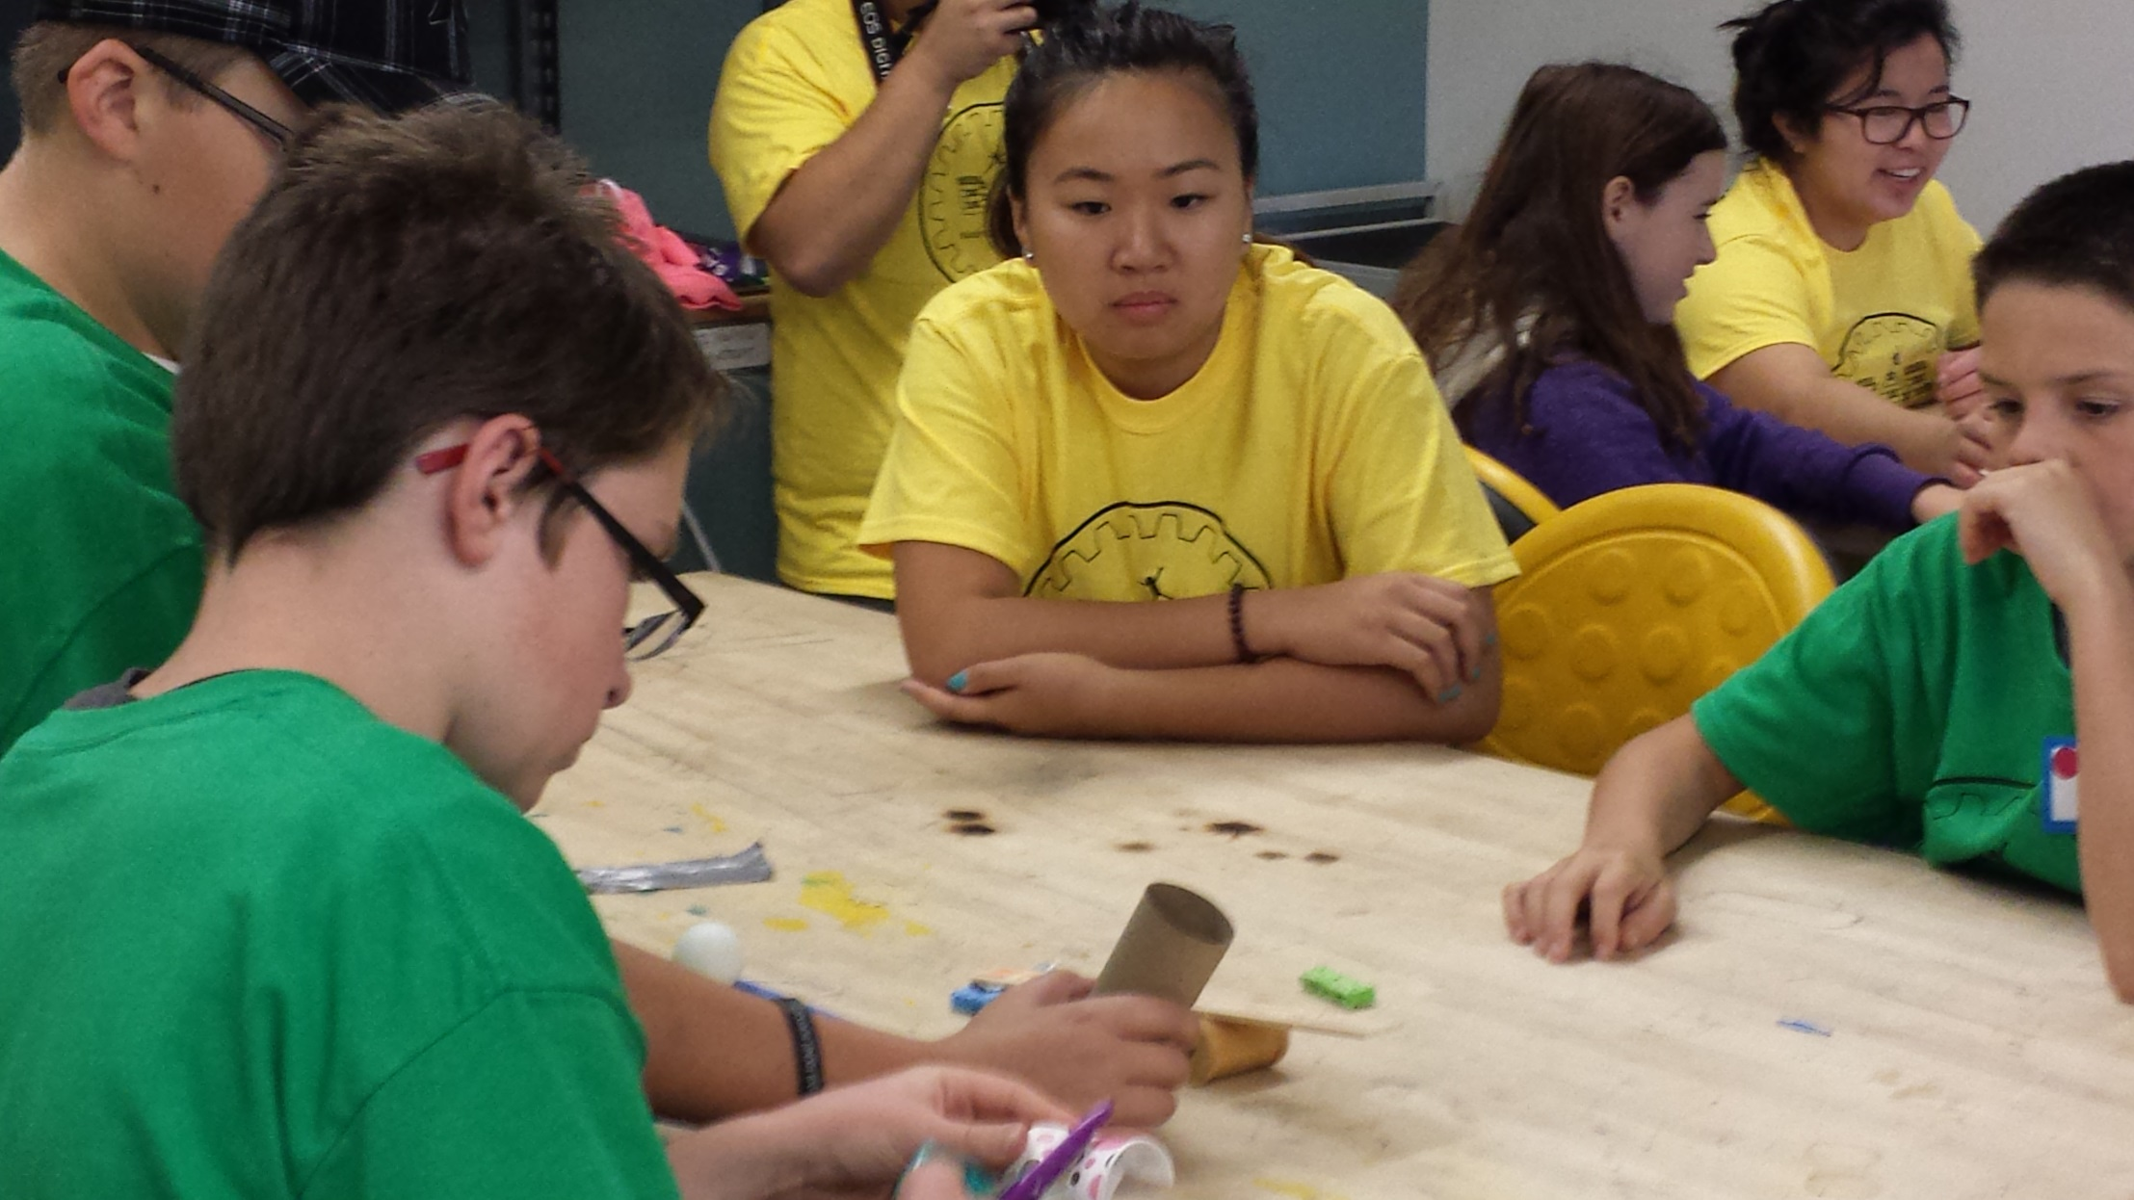
Design & Engineer

Slide 3
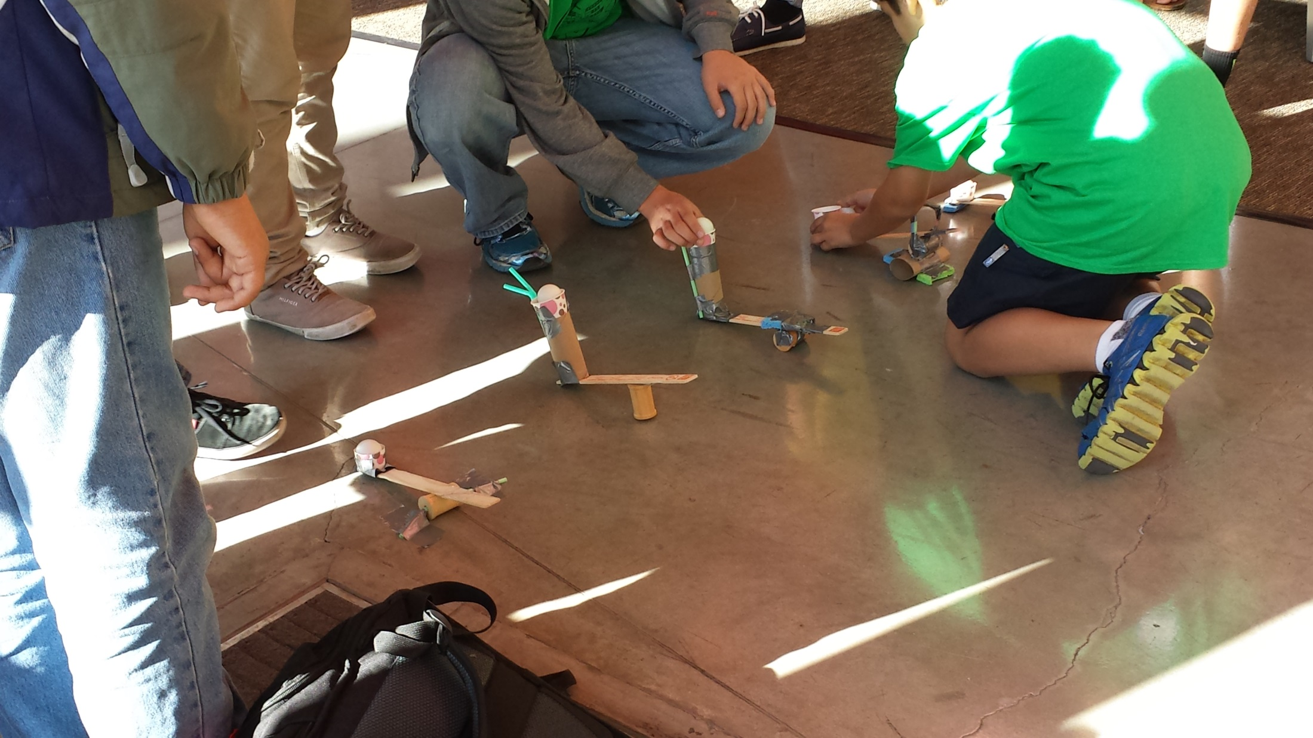
Catapult Prototypes

Slide 4
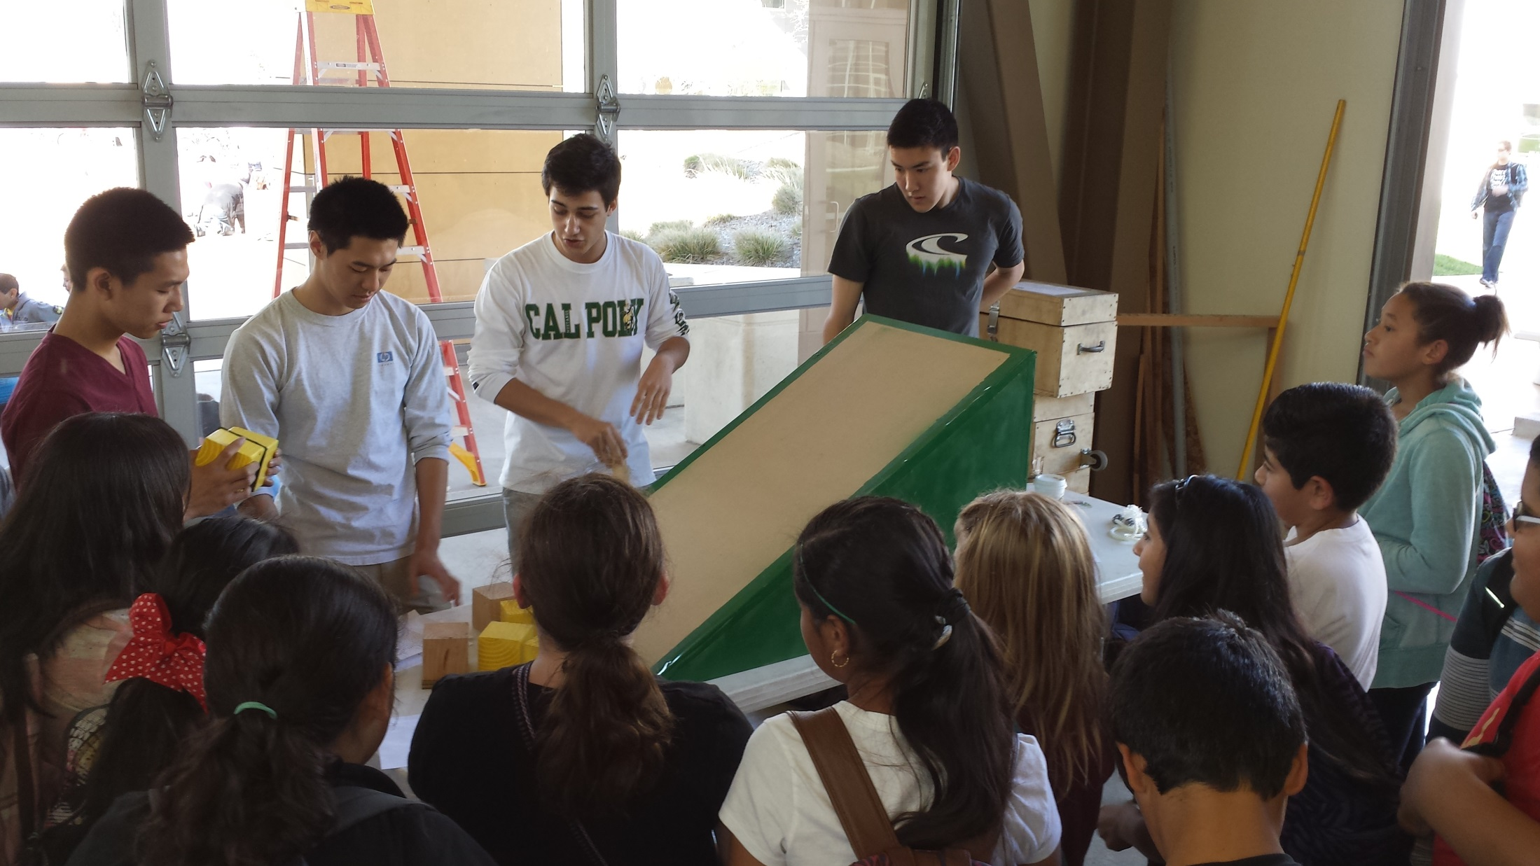
Sliding Friction Demo

Slide 5
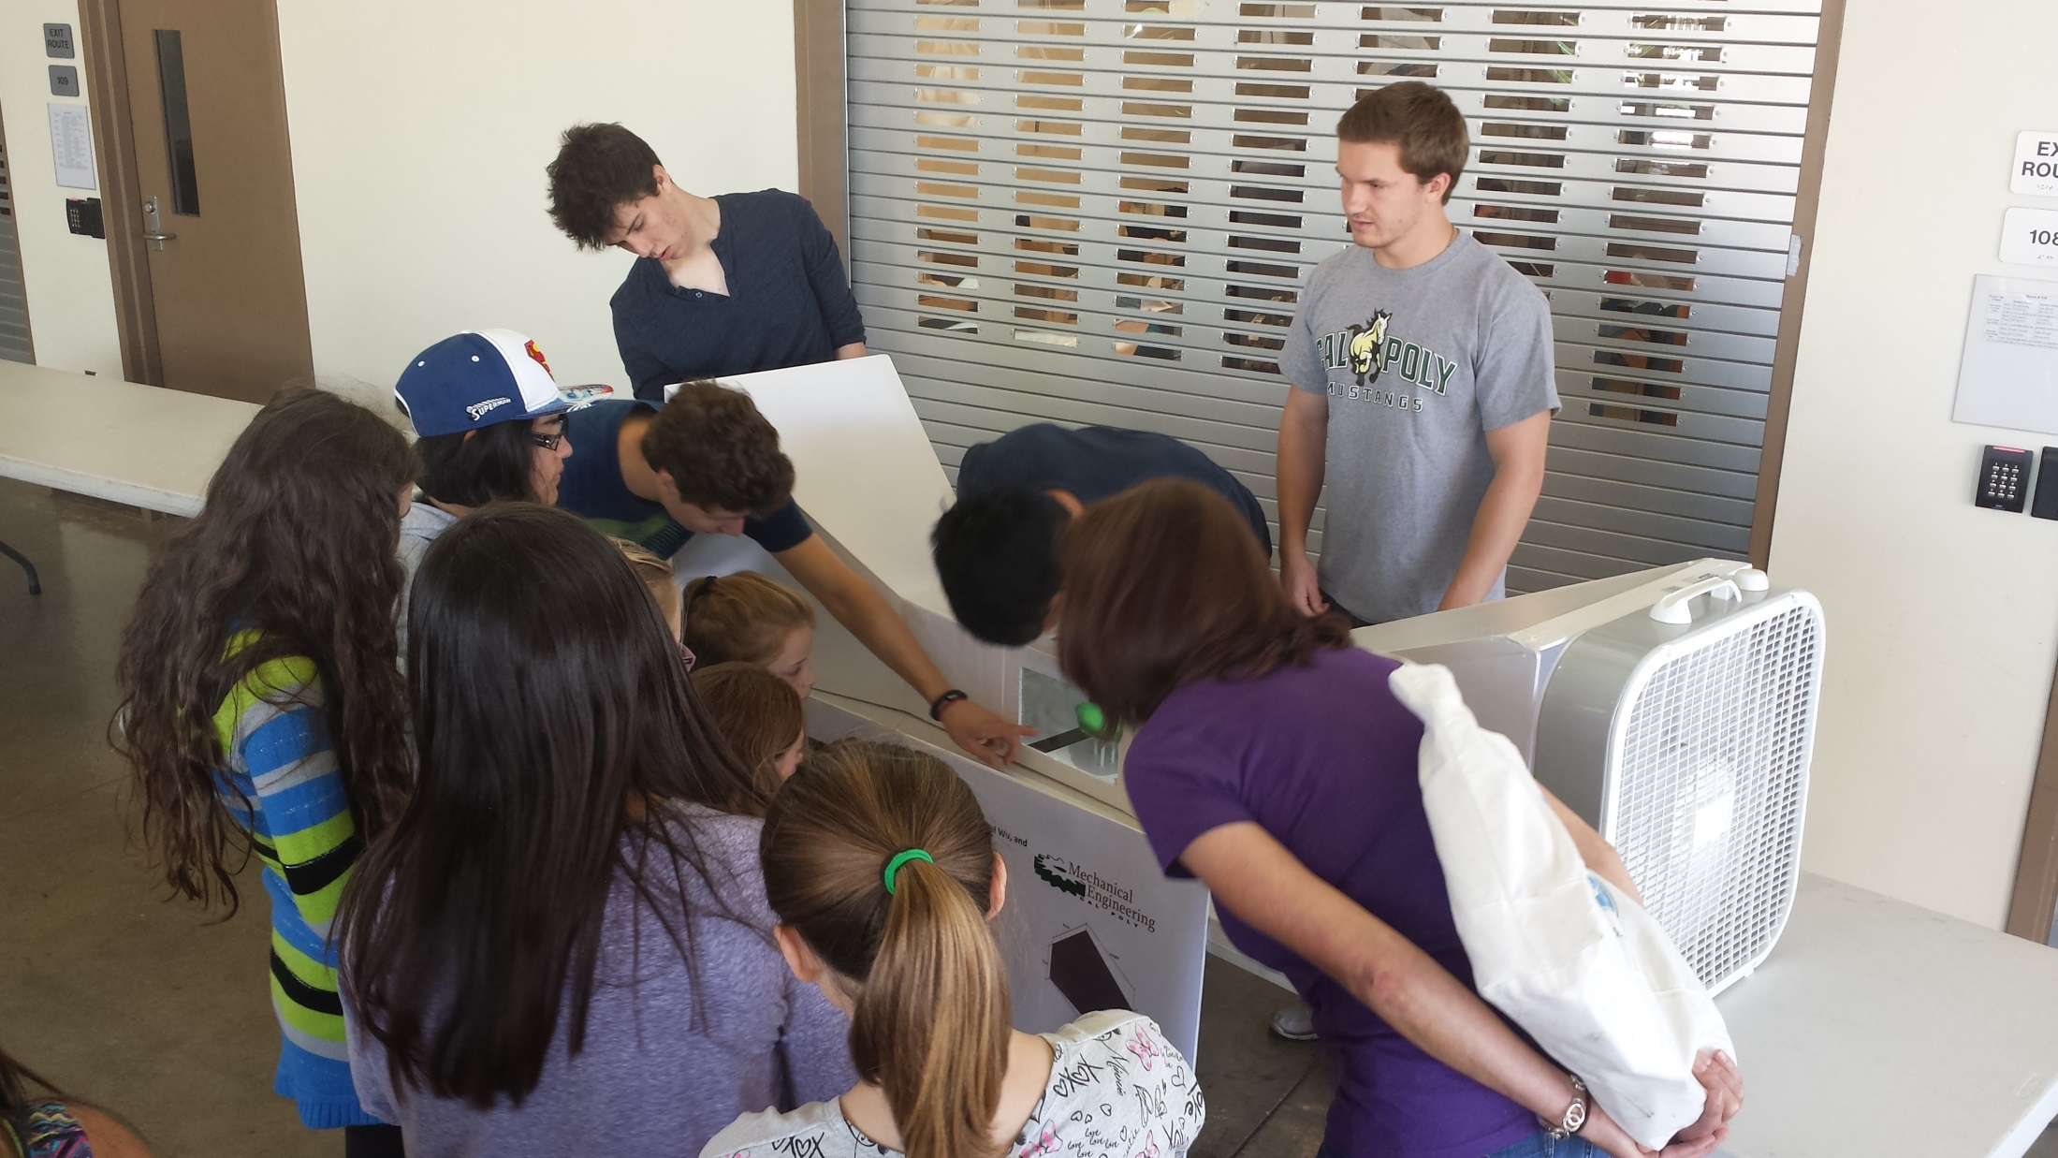
Wind tunnel test of student clay models

Slide 6
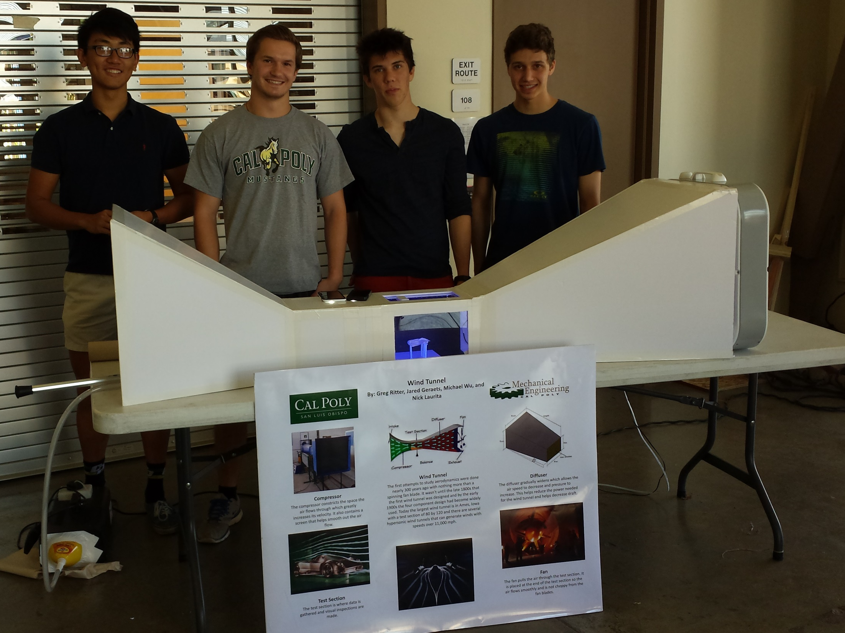

Slide 7
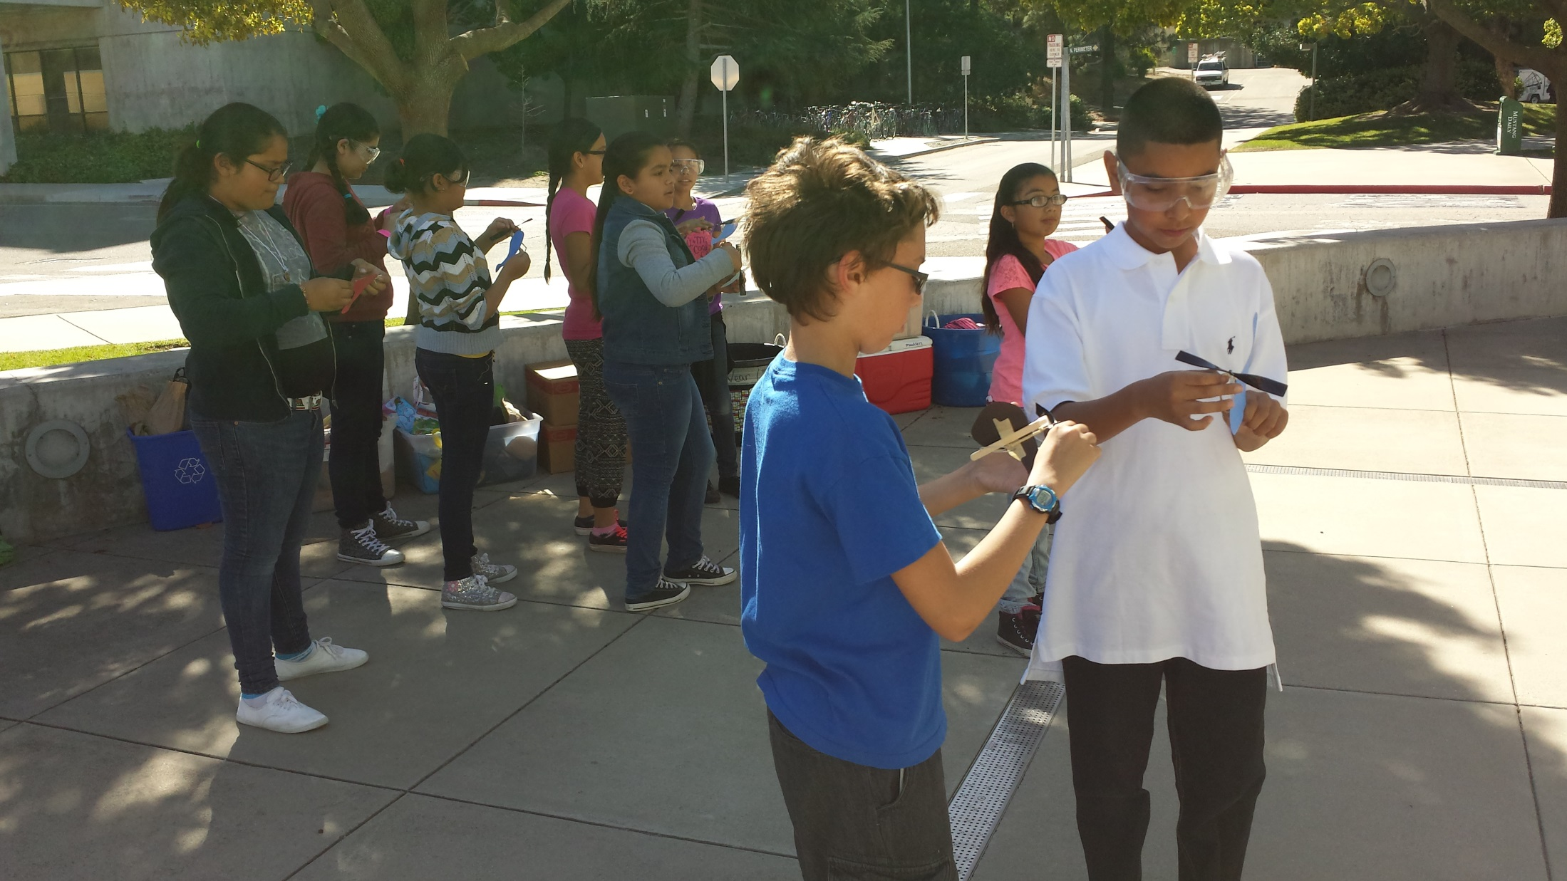
Helicopter build station

Slide 8
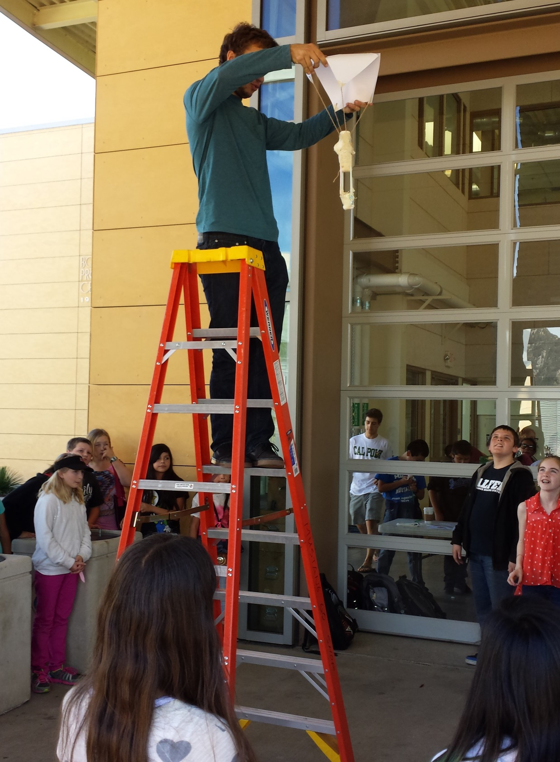
Recovery system design test

Slide 9
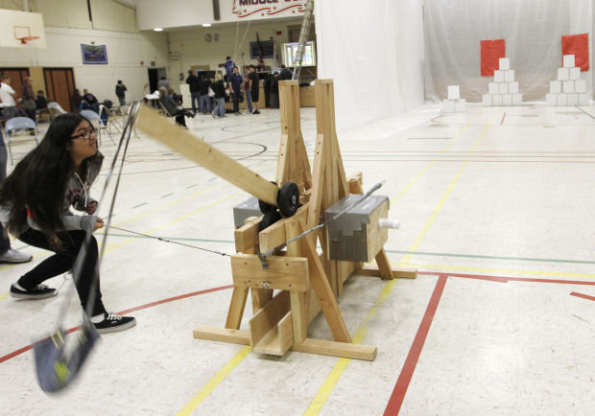
Trebuchet Wall Buster

Slide 10
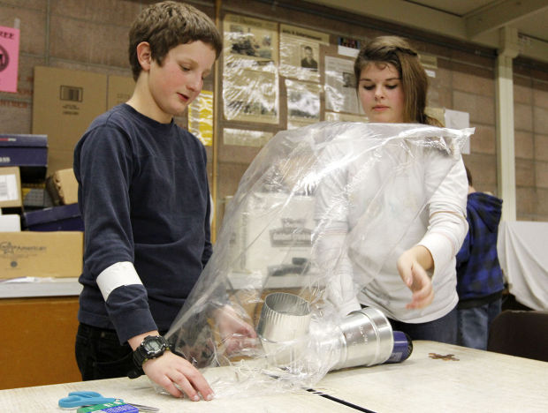
Hot Air Balloon

Slide 11
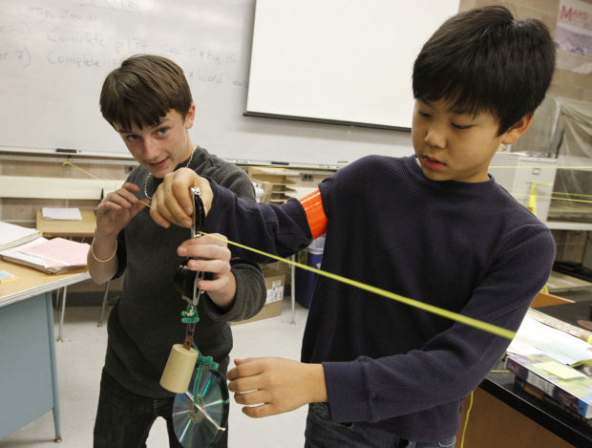
Zip line Races

Slide 12
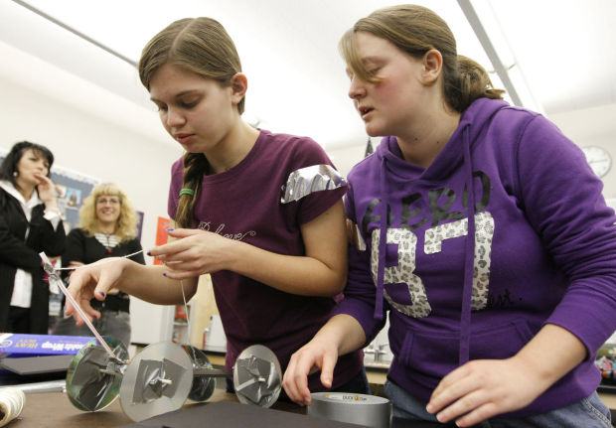
Newtoncars

Slide 13
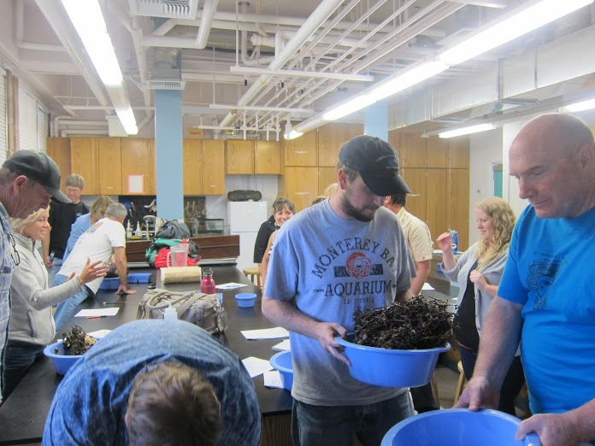
Kelp Holdfast Investigation

Slide 14
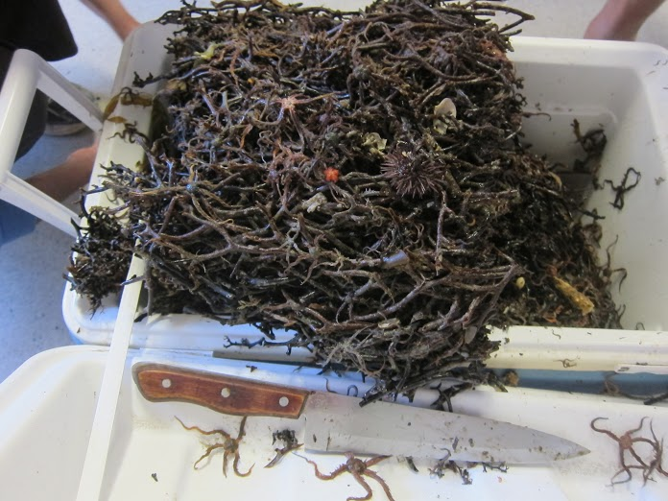

Slide 15
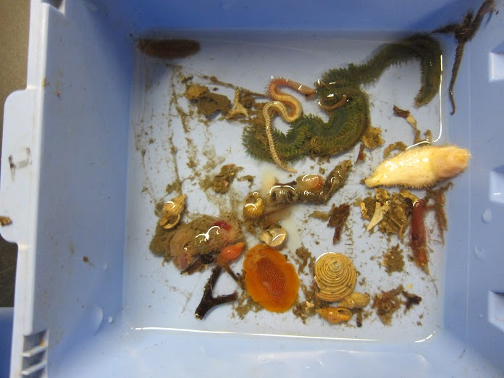
https://www.flickr.com/photos/usasef/with/14628274421/

Slide 16
Who are we seeking to Participate?
Teachers
Clubs
Student groups (of approximately 2 to 6)
Local businesses (e.g. Santa Barbara Skydive, Surf Connection, Hobby Shops, etc.).
Companies (e.g. United Launch Alliance, Raytheon, SpaceX, etc.)
Colleges and Universities (e.g. UCSB, Cal Poly, AHC)
Vandenberg AFB volunteers
Artists
Historians showing pivotal technology advancements.

Slide 17
How Can You Participate?
Sign-up for a class booth (e.g. Art design, Physics, Biology, Geology, New or Historic Technology, Anatomy, Chemistry, Marine Biology)
or
Have multiple student teams sign up for individual booths. Student teams develop a hands on activity or exhibit (Show or teach a Science, Technology, Engineering, Art, or Math concept)

Slide 18
How Can You Participate?
Get word out and encourage teachers in art design, clubs, ROP/CTE, history & technology to sign-up for a class or student booths.
Volunteer to be a Point of Contact (POC) for your campus recruit teachers and students to sign up for booths.
Get word out to community to participate May 29 from 6 to 8 pm. Offer incentives for students and families to participate ($$, A’s).

